Slide 1
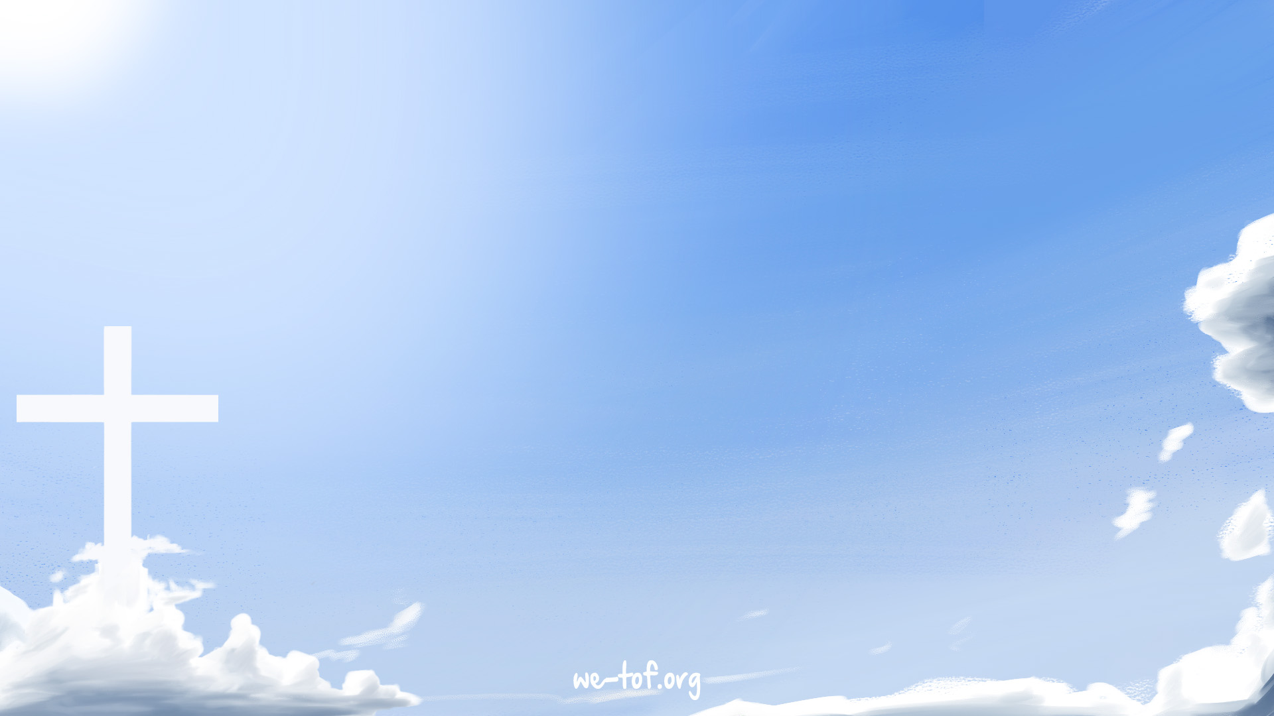
My God Is All I Need 有了神，我滿足

Slide 2
走在黑暗的幽谷
不見腳下前路
Dark, dark is the valley
Faint, the light at my feet

Slide 3

但無論面對何事
有了神，我滿足
But whatever may face me
My God is all I need

Slide 4
Bright, bright are the treasures
Life may offer to me
生活或能帶給我
寶藏五光十色

Slide 5

But whatever the pleasure
My God is all I need
但無論享受何樂
有了神，我滿足

Slide 6
He is my strength
when I cannot go on
Peace when all my power is gone
當我力竭，祂是我的力量
失落時，祂是我的平安

Slide 7
Hope, although the night
is long and deep
He is my song for He has rescued me
漫長黑夜中是我盼望。
祂拯救我，成為我的詩歌

Slide 8
Joy now He has set me free
Praise! Praise to my Father be
My God is all I need
釋放了我，給我大喜樂
讚美！都歸於天父
有了神，我滿足

Slide 9
一生日子何短暫
轉眼路程走完
Brief, brief are my days here
Soon my journey complete

Slide 10
但我仰望我救主
借祂，神賜滿足
有了神，我滿足
But I look to my Saviour
Where God has met my need
Yes, He has met my need

Slide 11
當我力竭，祂是我的力量
失落時祂是我的平安
He is my strength
when I cannot go on
Peace when all my power is gone

Slide 12
漫長黑夜中是我盼望。
祂拯救我，成為我的詩歌
Hope, although the night
is long and deep
He is my song for He has rescued me

Slide 13
釋放了我，給我大喜樂
讚美！都歸於天父
有了神，我滿足
Joy now He has set me free
Praise! Praise to my Father be
My God is all I need

Slide 14
My God is so big,
so strong and so mighty
There’s nothing my God cannot do
我神真偉大，祂滿有大能
在祂沒有難成的事

Slide 15
My God is so big,
so strong and so mighty
There’s nothing my God cannot do
我神真偉大，祂滿有大能
在祂沒有難成的事

Slide 16
The mountains are His,
the valleys are His
The stars are His handiwork too
祂造了高山，祂造了低谷
也造了穹蒼和星宿

Slide 17
My God is so big,
so strong and so mighty
There’s nothing my God cannot do
我神真偉大，祂滿有大能
在祂沒有難成的事

Slide 18
我神真偉大，祂滿有大能
在祂沒有難成的事
My God is so big,
so strong and so mighty
There’s nothing my God cannot do

Slide 19
我神真偉大，祂滿有大能
在祂沒有難成的事
My God is so big,
so strong and so mighty
There’s nothing my God cannot do

Slide 20
祂造了高山，祂造了低谷
也造了穹蒼和星宿
The mountains are His,
the valleys are His
The stars are His handiwork too

Slide 21
我神真偉大，祂滿有大能
在祂沒有難成的事 (2X)
My God is so big,
so strong and so mighty
There’s nothing my God cannot do

Slide 22
當我力竭，祂是我的力量
失落時祂是我的平安
He is my strength
when I cannot go on
Peace when all my power is gone

Slide 23
漫長黑夜中是我盼望。
祂拯救我，成為我的詩歌
Hope, although the night
is long and deep
He is my song for He has rescued me

Slide 24
釋放了我，給我大喜樂
讚美！歸都於天父
有了神，我滿足
Joy now He has set me free
Praise! Praise to my Father be
My God is all I need

Slide 25
He is my strength
when I cannot go on
Peace when all my power is gone
當我力竭，祂是我的力量
失落時，祂是我的平安

Slide 26
Hope, although the night
is long and deep
He is my song for He has rescued me
漫長黑夜中是我盼望。
祂拯救我，成為我的詩歌

Slide 27
Joy now He has set me free
Praise! Praise to my Father be
My God is all I need
釋放了我，給我大喜樂
讚美！都歸於天父
有了神，我滿足 (2X)

